Slide 1
Zara Fashion Trends – Prediction Model
Elsa Figueroa
Gauri Gupta
Miga Budaasuren
Termeh Mohebbie

Slide 2
Table of Content
01
Introduction
04
Models
Venus has a beautiful name, but it’s hot
Despite being red, Mars is a cold place
02
Data Pre Processing
Limitations
05
Mercury is the closest planet to the Sun
Saturn is the only planet with rings
03
Feature selection
06
Conclusion
The Earth is the third planet from the Sun
Jupiter is the biggest planet of them all

Slide 3
Introduction and Goal
Predictive analytics is an advanced analytics method that leverages historical data, statistical modeling, data mining, and machine learning techniques to predict future outcomes. Companies use predictive analytics to identify risks and opportunities by finding patterns in data. Predictive analytics is associated with big data and data science. Data scientists use machine learning algorithms such as deep learning, logistic and linear regression models, neural networks, and decision trees to make predictions and gain insights from data. These modeling techniques can build on initial predictive insights to make additional predictions.
The main goal is to predict best-performing products for the last week in terms of revenue using the previous weeks data.

Slide 4
Data processing and Feature Engineering
Correlation Matrix with Heatmap
01
This matrix is showing how the features are correlated or not. It can help identify which variables are strongly correlated and which ones are not, and can be used to guide feature selection and data preprocessing steps in machine learning and data analysis tasks.
EDA
03
Investigating and summarizing the main characteristics and patterns of the data using visual and quantitative methods.
Principal Component Analysis
02
By reducing the number of dimensions, PCA can help reduce the computational complexity of subsequent machine learning models, while retaining as much of the relevant information as possible.
k-means
04
K-means is used to find optimal number of clusters

Slide 5
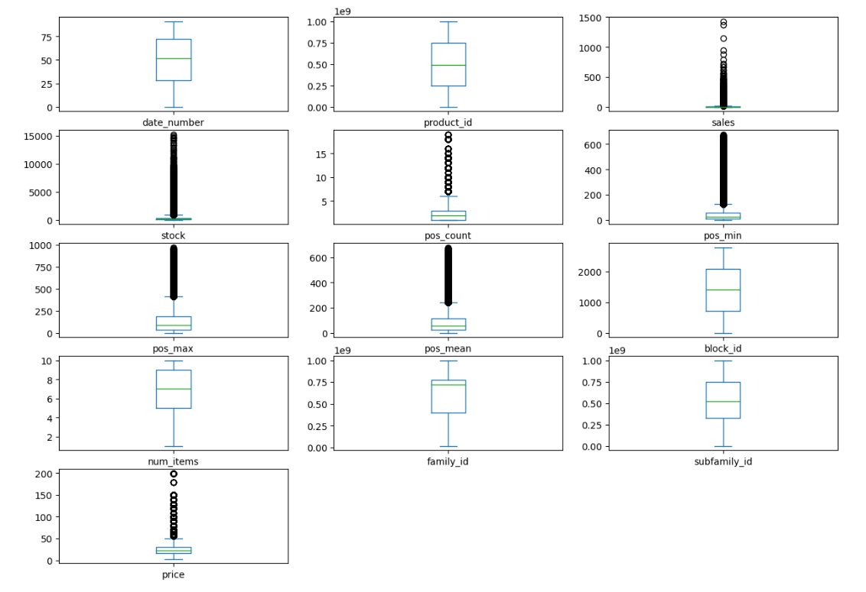
Graphical represenation
Boxplot
Mercury is the closest planet to the Sun

Slide 6
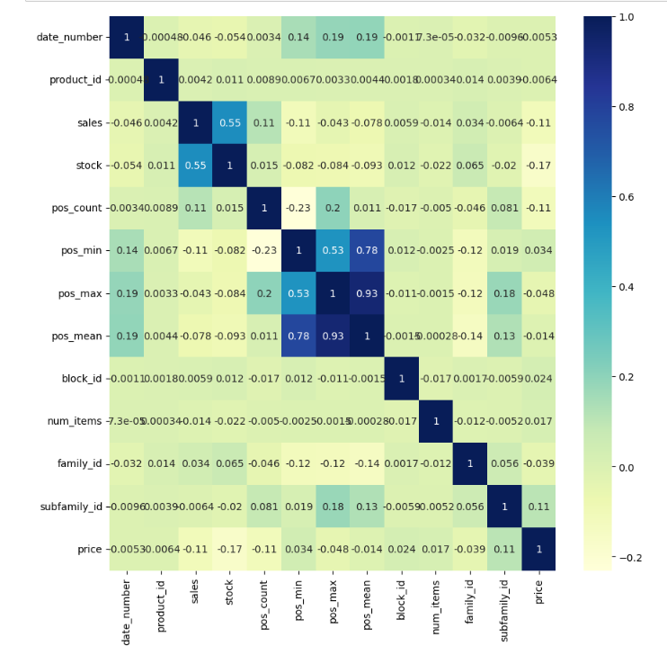
Graphical represenation
Heatmap

Slide 7
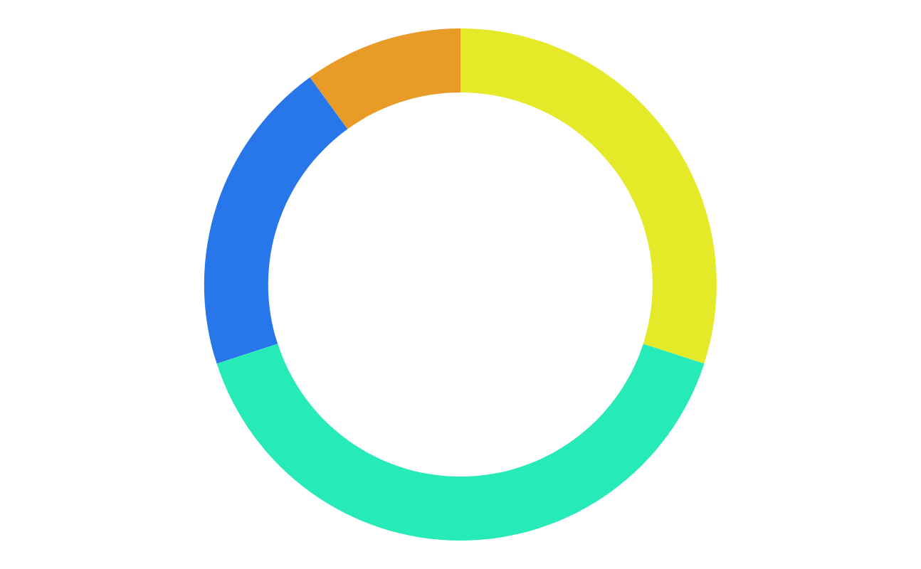
Machine Learning Models findings
Random forest
Gaussian NB
Mercury
Jupiter
Jupiter is a gas giant and the biggest planet
XG Boost
Logistic regression model
Neptune
Mars

Slide 8
Limitations
01 | Supervised learning
 | Venus has a beautiful name, but it’s hot
02 | Unsupervised learning
 | Despite being red, Mars is a cold place
03 | Semi-supervised learning
 | The Earth is the third planet from the Sun
04 | Reinforcement learning
 | Mercury is the closest planet to the Sun
05 | Dimensionality reduction
 | Pluto is considered a dwarf planet

Slide 9
Conclusion
01 | Supervised learning
 | Venus has a beautiful name, but it’s hot
02 | Unsupervised learning
 | Despite being red, Mars is a cold place
03 | Semi-supervised learning
 | The Earth is the third planet from the Sun
04 | Reinforcement learning
 | Mercury is the closest planet to the Sun
05 | Dimensionality reduction
 | Pluto is considered a dwarf planet

Slide 10
How Zara Uses Artificial Intelligence to Predict Trends
Similar to its competitor H&M, Zara, the Spanish fashion retailer, has implemented artificial intelligence to support its business objectives. The company leverages AI in several ways, such as utilizing AI robots to fulfill customer orders through its Buy Online, Pick-Up in Store (BOPIS) or Click and Collect services. Unlike H&M, which heavily relies on outsourcing to speed up production, Zara minimizes its use of outsourcing. This strategy grants Zara greater control over its supply chain, from design to display to shipping, which enables the collection of valuable data at every stage of the process. This data is analyzed to identify inefficiencies, successes, and improve forecasting accuracy. To augment its inventory management, Zara partnered with Tyco to implant microchips in clothing security tags, allowing the company to monitor the location of specific styles and sizes throughout the supply chain. Additionally, Zara collaborates with Jetlore, a consumer behavior prediction platform that uses AI to map consumer behavior into structured predictive attributes, such as size, color, fit, and style preferences. This structured data helps Zara optimize content and communication for consumers, make better merchandising decisions, improve search, and enhance customer service.

Slide 11
AI Is Influencing Fashion
The irony is that artificial intelligence is doing more than just predicting trends. It’s also influencing them.
AI tracks shoppers’ behavior patterns online so it can offer a personalized shopping experience. Machine learning gathers data on what a shopper likes and when and how often they make certain purchases. Its predictive technology then allows it to anticipate a shopper’s needs and desires so it can offer them similar products. It even learns when online shoppers are more likely to be open to trying out a new brand.
In this way, AI can be used to introduce shoppers to new brands and styles, push bulging inventory, and drive trends.
tasks.

